Slide 1
Introduction to our Simulink Model

Slide 2
Introduction about model
The model simulates how a photovoltaic (PV) panel operates under varying conditions and ensures that the solar energy is extracted efficiently by dynamically adjusting the operating point.
Key Objectives of the Model:
Model the PV system using a realistic PV array block with irradiance and temperature as inputs.
Implement MPPT using the Perturb & Observe algorithm to track the maximum power point dynamically.
output waveforms of voltage, current, and power of the MPPT tracking effectiveness.
Prepare for fault detection mechanisms to enhance the robustness of the system (to be added later).

Slide 3
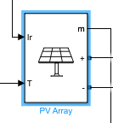
Understanding the Blocks Used and Why They Were Chosen
PV Array (Solar Panel)
Inputs
Irradiance (W/m²) → Sunlight intensity.
Temperature (°C) → Affects PV efficiency.
Outputs
Voltage (V_PV) → Output voltage of the PV panel.
Current (I_PV) → Output current of the PV panel.
The Voltage Measurement and Current Measurement blocks extract V_PV and I_PV, which are then sent via a Bus Selector to the control system.

Slide 4
Power Conversion (DC-DC Converter) Section
Blocks Used:
MOSFET (Insulated Gate Bipolar Transistor)
Diode
Series RLC Components (Inductor, Capacitor, Resistor)
Current & Voltage Measurement
PWM Control Signal (Switching Control)
Explanation:
A Boost Converter (DC-DC) topology is used to regulate the output voltage.
The IGBT switch and diode form the switching circuit, controlling energy transfer.
Inductor and capacitor smoothen voltage and current ripples.
The RLC components act as a filter to maintain a stable DC output.
PWM Generator controls the IGBT switching, determining the power drawn from the PV panel.

Slide 5
Boost Converter (Power Conditioning)
Function:
Converts unregulated DC output from the PV panel to a higher, stable DC voltage suitable for the load.
Why This Block?
It ensures proper voltage level for the load.
The PWM generator modulates the duty cycle dynamically based on MPPT.
Measurement Blocks
Bus Selector Block: Extracts V_PV and I_PV signals.
Product Block: Multiplies V_PV × I_PV to get Power (P) Output.
Scope Block: Displays Voltage, Current, and Power waveforms over time.
Why These Blocks?
They enable real-time monitoring of PV behavior.
The scope provides graphical validation of MPPT tracking efficiency.

Slide 6
MPPT Control Logic (Perturb & Observe)
Blocks Used:
Multiplication Block (Power Calculation)
Unit Delay
Sum Block (∆P and ∆V Calculation)
Gain Block (-1)
Switch Blocks
Constant Block (Step Size)
Saturation Block (Limits change in duty cycle)

Slide 7
PI Controller & PWM Generator
Blocks Used:
PI Controller
PWM Generator (DC-DC)
Goto Block (PWM Signal Distribution)
Explanation:
The PI Controller refines the duty cycle adjustment for better stability.
The PWM Generator converts the duty cycle into a high-frequency switching signal.
The Goto Block sends the PWM signal to the Boost Converter for IGBT switching.

Slide 8
The MPPT algorithm tracks the Maximum Power Point (MPP) of the PV panel to extract maximum energy.
Power Calculation
Power P = V_PV × I_PV is computed.
The previous power value is stored using a Unit Delay block.
Change in Power (∆P) and Voltage (∆V) Calculation
∆P = P(k) - P(k-1)
∆V = V(k) - V(k-1)
A Sum Block computes these changes.
Decision Making using P&O Algorithm
If ∆P > 0 and ∆V > 0, the duty cycle increases.
If ∆P > 0 and ∆V < 0, the duty cycle decreases.
If ∆P < 0, the direction of perturbation is reversed.
Switch Blocks are used to implement these conditions.
Step Size Adjustment
A Constant Block (0.01) defines the step size for duty cycle adjustment.
Gain Block (-1) negates values when required.
A Saturation Block ensures the duty cycle remains within limits.

Slide 9
1. Complete Circuit Overview
Major Sections:
PV Panel & Measurements
Converts solar irradiance to electrical power.
Measures Voltage (V_PV) and Current (I_PV).
Sends data to MPPT logic.
Boost Converter & Power Regulation
Uses IGBT, Diode, Inductor, Capacitor, and Resistor to increase PV voltage.
PWM control regulates the switching action.
MPPT Algorithm (Perturb & Observe)
Computes Power (P = V × I).
Calculates change in power (∆P) and voltage (∆V).
Adjusts the PWM duty cycle accordingly.
Control Logic & Output Monitoring
PI Controller refines the tracking process.
Scope logs output values (Voltage, Current, Power).
Additional Unit Delay, Sum, and Product blocks complete the feedback system.

Slide 10
How to Verify MPPT is Working?
Scope blocks:
Voltage (V_PV) – The output voltage of the PV array.
Current (I_PV) – The current drawn from the PV array.
Power (P = V_PV * I_PV) – The product of voltage and current, which represents the power output of the PV array.
Voltage (V_PV) Analysis
The first plot shows V_PV as a nearly constant value.
Expected MPPT behavior:
If MPPT is working, V_PV should adjust dynamically in response to irradiance changes.
However, in a steady-state condition, V_PV stabilizes once the maximum power point is reached.
Does this confirm MPPT?
If you injected a fixed irradiance (without a varying sun condition), V_PV should remain constant after reaching MPP.
If you injected variable irradiance (e.g., a sinusoidal irradiance wave), V_PV should oscillate slightly as MPPT adjusts.

Slide 11
Power (P = V_PV * I_PV) Analysis
The second plot shows Power (P) reaching a stable maximum value.
Expected MPPT behavior:
If MPPT is working correctly, Power should increase at the beginning of the simulation until it reaches MPP.
If irradiance is changed dynamically (sinusoidal or step), Power should adjust accordingly.
🔹 Does this confirm MPPT?
Since power reaches a stable high value, this suggests that MPPT has successfully converged to the maximum power point.

Slide 12
🔹 Current (I_PV) Analysis
The third plot shows I_PV, the current drawn from the PV panel.
Expected MPPT behavior:
As the P&O algorithm adjusts the duty cycle, current should change correspondingly.
If MPPT is active, current should not be a flat line—it should adjust when irradiance changes.
🔹 Does this confirm MPPT?
If you have a step irradiance input, I_PV should initially fluctuate before stabilizing.
If you have a sinusoidal irradiance, I_PV should vary sinusoidally.

Slide 13
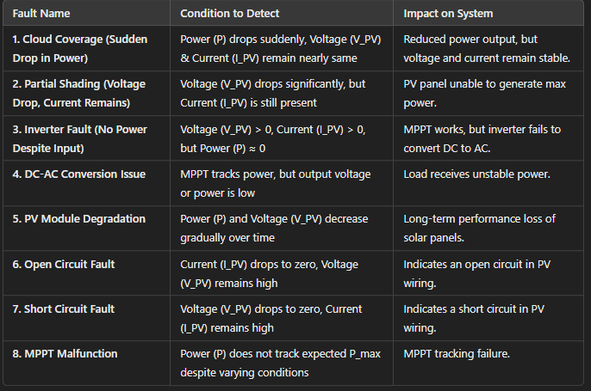
Faults to add and simulate

